Slide 1
IBM Cloud Overview

Slide 2
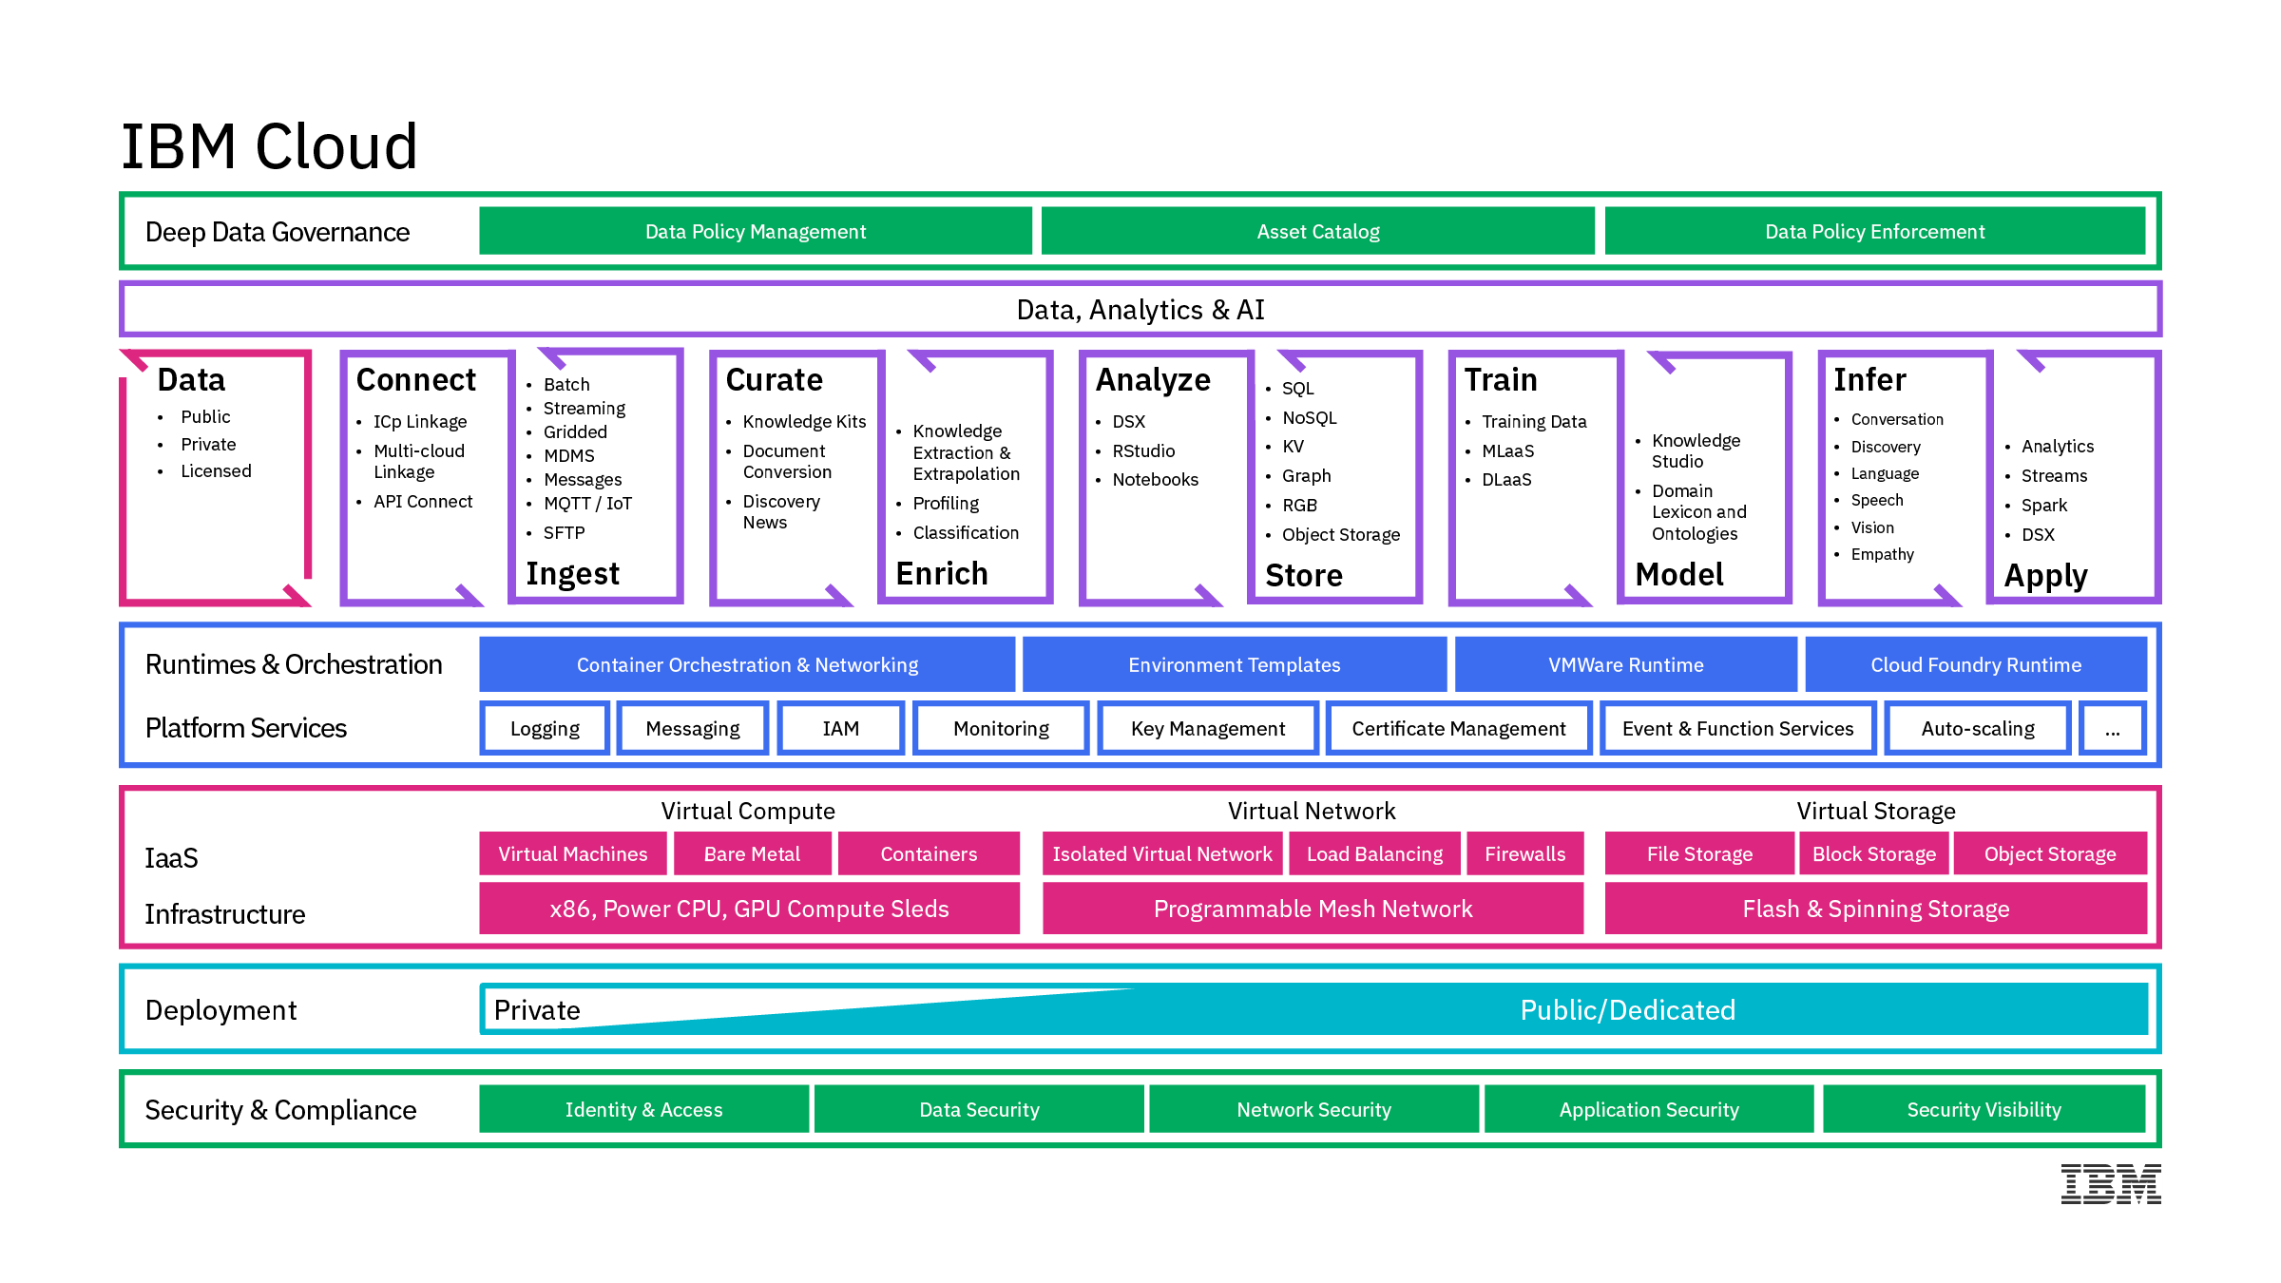
Architecture
2

Slide 3





IBM offers the complete spectrum of cloud deployment models to support clients wherever they are in their Cloud Journey
Choice with consistency
Hybrid integration
PUBLIC
DEDICATED
PRIVATE
DevOps productivity
Maximize on cloud agility and economics
Public cloud benefits, with dedicated infrastructure
Behind the firewall for the most demanding workloads
Powerful, accessible data and analytics
Cognitive solutions
Seamless Experience
Regardless of which combination you choose, you get a single, seamless experience.
3
Notes:
IBM offers the complete spectrum of cloud deployment models to meet your needs
Seamless experience, including…. see points on chart
*****
A successful multi-cloud adoption includes a seamless experience across all clouds, regardless if they are Public (hosted off-premises), Dedicated (hosted off-premises but in an environment dedicated to only a specific organization), or Private (customer managed within the firewall of an organization’s data center).
IBM’s strategy is to provide a seamless experience across all three environments, which includes:
Choice with consistency
Hybrid integration
DevOps productivity
Powerful, accessible data and analytics
Cognitive solutions
Regardless of which combination of cloud adoption an organization chooses, IBM delivers a seamless experience.

Slide 4
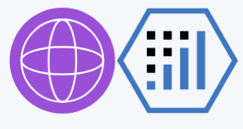










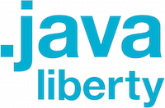
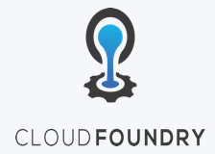
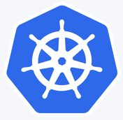


Hybrid Cloud is a key differentiator
IBM provides the strongest cloud integration
for unified cloud native developer experience
across Public & Private Clouds
IBM Cloud Public
IBM Cloud Private
AI/Machine Learning/Data Services
Bring IBM Middleware apps and license to IBM Cloud
Region Level Cloud APIs (HA/DR)
IBM Middleware, Data, Analytics
API Connect
& Mgmt
IBM Middleware, Data, Analytics (BYOL or aaS)
Connect
+
Web
Data
Mobile
Cognitive
Analytics
IoT
Security
Core Operational Services
Language Runtimes
Extend
Federated Catalog
Core Operational Services
Language Runtimes
API Cnnect
& Mgmt
Modernize
API Cnnect
& Mgmt
Kubernetes-based Container Platform
Kubernetes-based Container Platform
Migrate
Serverless Computing
VSI
SAP certified servers
Cloud Object Store
LBaaS
Dedicated Env
4
Notes:
I talked earlier about IBM Hybrid Cloud solution as a key differentiator in the Cloud Wars. This is a visual of that single architecture.
We have the strongest cloud integration for unified cloud native developer experience across Public & Private Clouds.
The IBM Cloud is optimized for cognitive workloads and provides clients with the ability to integrate public, private, and managed environments through a single architecture.
We have been working with Arvind’s team on the Hybrid Cloud Alignment motion to demonstrate this at Think.

Slide 5
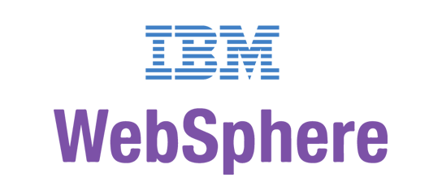
Solution Overview
IBM Middleware, Data, Analytics and Developer Services
Cloud enabled middleware, messaging, databases, analytics, and cognitive services
Core Operational Services Simplify Operations Management, Security, and Hybrid integration Provision infrastructure and apps across Multi-Cloud environments
Kubernetes-based Container Platform
Industry leading container orchestration platform
Cloud Foundry
For prescribed app dev & deployment
Terraform
For multi-cloud management
(Cloud Automation Manager)
Runs on existing IaaS:
System Z
IBM Spectrum
5
5

Slide 6


IBM Cloud private transforms the way IT operations and developers work
Todd
Operations / Admin
Responsible for infrastructure, security, and management of the environment.
Jane
Enterprise Developer
Responsible for modernizing existing applications and creating new Cloud Native Workloads.
IBM Cloud private empowers both operations and developers to meet business demands:
IT Operations and Administrators
Quickly set up a modern, flexible, and compliant private cloud
Integrate with existing management tools and processes
Developers
Rapidly create new cloud-native applications, optimize existing ones, and securely connect their applications with data and services across all clouds
Notes:
And through this integrated platform, IBM Cloud Private transforms the way IT Operations and Enterprise Developers work. It helps them become more efficient in their roles, and it accelerates their innovation:
IT Operations and Administrators can quickly set up a modern, flexible, and compliant private cloud
Developers can create new cloud-native applications, optimize existing ones, and securely connect their applications with data and services across all clouds

Slide 7
Use cases driving private cloud adoption
1. Optimize legacy applications with cloud
2. Open your data center to work with cloud services
3. Create new cloud native applications
Public Cloud Services
Self-service Experience
APIs
New Applications
Next Generation Middleware, Data & Analytics
Integration Services & Cloud Native Programming Models
Machine Learning on p/z
Cloud Native Services & Runtimes
Blockchain
Automation & Orchestration
Automation & Orchestration
Automation & Orchestration
Business Process
Containers &
Common Services
Containers &
Common Services
Data & Apps
Containers &
Common Services
On-Premises Software & Services
Cloud-enabled middleware
Integration & Hybrid Cloud
New
Applications
Notes:
What I just laid out on the story…get to Quincy…this is what I want my speech at Interconnect to be…use these proof points…

Slide 8
IBM Cloud private architecture (Stack view)

Slide 9
IBM Cloud private Architecture overview (Node view)
Boot node
Master nodes (1 or 3 or 5)
ETCD node
(0 – n)
Proxy nodes (1 or 3 or 5)
Worker nodes
(3 - n)
LDAP
Ansible based installer
Ansible based cluster mgnt
Load Balancer
Config files
Mgt node
(1 – n)
VA nodes (1 or 3 or 5)
HA Storage
NOI infrastructure
IaaS

Slide 10
Content available by Edition
Discover and Try software available in all editions
IBM Cloud Private Cloud Native
IBM Cloud Private Enterprise
Toolchain & Runtimes
Microclimate Beta
Microservice Builder
Jenkins (open source)
IBM WebSphere Liberty
Open Liberty (open source)
IBM SDK for Node.js
Swift runtime sample (open source)
Nginx (open source)
Messaging
MQ Advanced for Developers
RabbitMQ (open source)
Integration
IBM Integration Bus for Developers
IBM DataPower Gateway for Developers
Data Services
IBM Db2 Dev-C
IBM Db2 Warehouse Dev-C
IBM Data Server Manager (for Db2 Dev-C)
IBM Cloudant Developer Edition
MongoDB (open source)
PostgreSQL (open source)
MariaDB (open source)
Galera clustering with MariaDB (open
source)
Redis HA Topology (open source)
Catalog of Discover & Try content, plus …
Toolchain & Runtimes
Microservice Builder ^{[1]}
IBM WebSphere Liberty ^{[1]}
IBM SDK for Node.js ^{[1]}
Multi-Cloud Management
IBM Cloud Automation Manager ^{[1]}
Cloud Native content, plus…
Runtimes
IBM WebSphere Application Server ND ^{[1] [2]}
Messaging
IBM MQ Advanced ^{[1]}
Integration
IBM API Connect Professional ^{[1] [2]}
Data Science
IBM Data Science Experience Developer
Edition
Data Governance and Integration
IBM InfoSphere Information Server
for Evaluation
App Modernization Tooling
IBM Transformation Advisor
Digital Business Automation
IBM Operational Decision Manager
Developer Edition
Connectivity
IBM Voice Gateway Developer Trial
Management
IBM Netcool -integration ^{(Probe for ICP Services}
-Logging events & Monitoring alerts)
HPC / HPDA
IBM Spectrum LSF Community Edition
IBM Spectrum Symphony Community
Edition
IBM Spectrum Conductor Tech Preview
Tooling
Web Terminal (open source)
Skydive Network Analyzer (open source)
[1] IBM Software bundled with Cloud Native or Enterprise editions is entitled for production use with subscription and support.
[2] Runs on VMs
outside of Kubernetes
Optional add-ons to
Cloud Native or Enterprise
Data Services
IBM Db2 Direct Advanced Edition
IBM Db2 Warehouse Enterprise
(in ICP for Data Science PN)
Data Science
IBM Data Science Experience Local
Toolchain
IBM UrbanCode Deploy (now on ICP)
Cloud Foundry
Includes select buildpacks
Messaging
IBM MQ Advanced
Integration
IBM Integration Bus
IBM DataPower Gateway Virtual Ed
IBM API Connect Enterprise
IBM API Connect Professional
Watson
IBM Watson Compare & Comply: Element Classification
Data Services
IBM Db2 Direct Advanced Ed. / AESE
with IBM Data Server Manager
IBM Db2 Warehouse Enterprise
Data Science & Business Analytics
IBM Watson Explorer Deep Analytics Edition
Digital Business Automation
IBM Operational Decision Manager
Mobile
IBM Mobile Foundation
Available a la carte
Separate purchase or
bring your existing license
Catalog content is not distributed with IBM Cloud Private. Content is distributed separately, licensed under separate terms and conditions.
*coming soon
Notes:
ICP License explicitly states the following about software available through the catalog: “Program allows Licensee to access and download additional IBM and non-IBM software. Entitlement to additional software is obtained separately from the Program and will have separate terms. Licensee agrees that those terms may be presented only in English.”

Slide 11
IBM Cloud Private How does our platform add value?

Slide 12
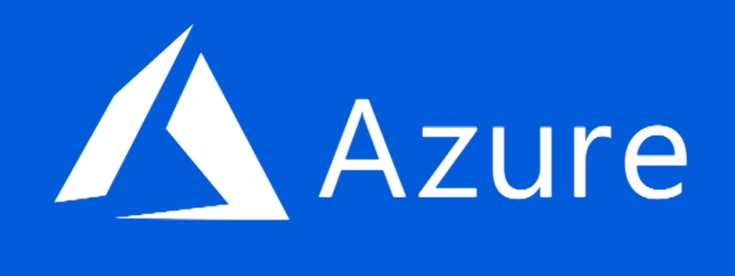

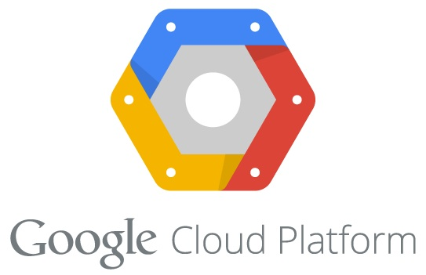

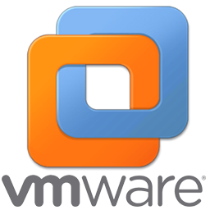

IBM Cloud Automation Manager on IBM Cloud Private
Containerized cloud native application
Installed into an IBM Cloud Private worker node with a Helm chart
Leverages IBM Cloud Private services for enterprise capabilities
Deployment & Process Orchestration
Service & Template
Library
3rd Party Integrations
Service
Composer
Flow Engine
Template Management
Instance Management
Template API
Workload
Terraform
Helm
Service
Public, Private & Hybrid Clouds
IaaS Management
IBM Cloud Private
Service catalog
Multi-cloud
Services
Infrastructure
Data & Analytics Services
Core Services
Kubernetes
Databases
Analytics
CAM
IAM
Logging
Audit
API & Data Connect
Encryption & Key Management
Monitoring
Usage
Metering
Event
Tenant Svcs

Slide 13

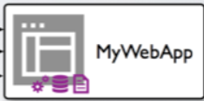
Most apps today aren’t in containers
… and customers need help to modernize these workloads
IBM Transformation Advisor enables insights into existing apps which is part of our universal platform for IBM middleware in containers

Slide 14
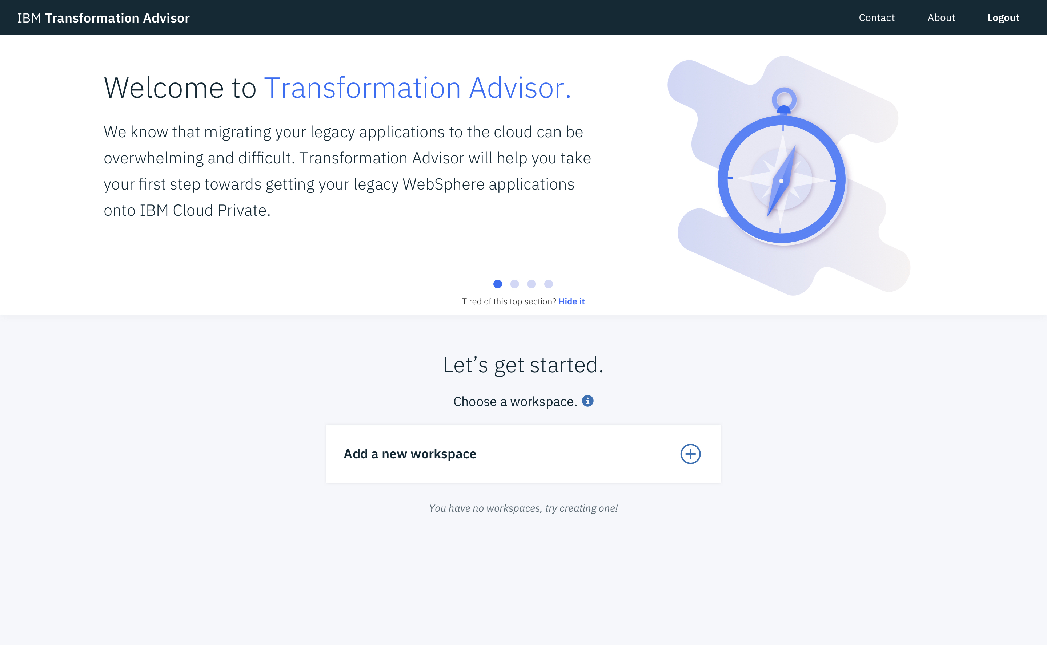
IBM Transformation Advisor
Transformation Advisor is a tool that consumes information about your WebSphere Environment and Applications. These inputs are combined with rules and insights gained from years of working with WebSphere and WebSphere applications to provide recommendations for your cloud journey.
CHALLENGES
Leverage existing application logic
Need to accelerate application development and maintenance
Monolithic applications that are complex and brittle
BENEFITS
Included and deployed on IBM Cloud Private
Introspects existing WebSphere Deployments
THE source of truth
Provides recommendations for Application Modernization
Enabling app modernization for our existing estates is part of our universal platform for IBM middleware in containers

Slide 15
Transforming innovative ideas
… into business value delivered through containers
IBM Microclimate enables rapid creation of new apps which is part of our universal platform for IBM middleware in containers

Slide 16
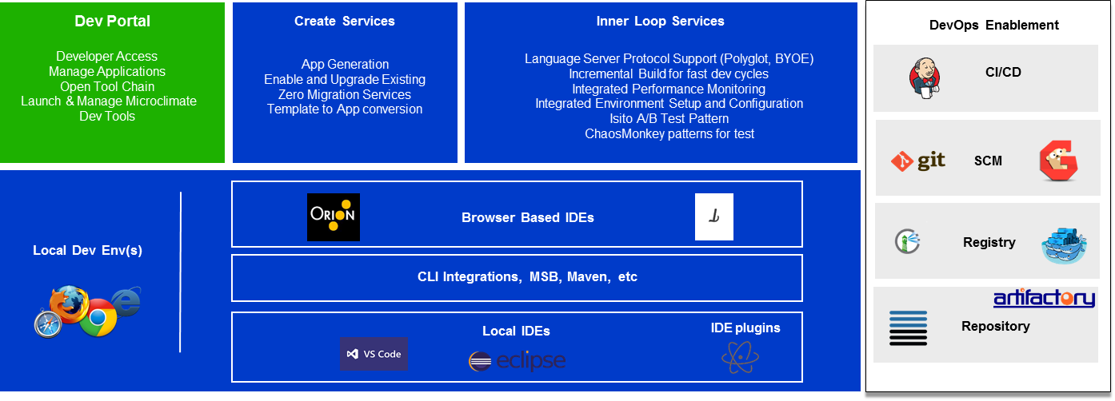
IBM Microclimate
Microclimate is an end to end development environment that lets you rapidly create, edit, and deploy applications. Applications are run in containers from day one and can be delivered into production on Kubernetes through an automated DevOps pipeline using Jenkins. Microclimate can be installed locally or on IBM Cloud Private.
LEGEND:
ICP
Microclimate Local or ICP
Option for 3rd Party
Providing an integrated DevOps experience for all apps is part of our universal platform for IBM middleware in containers

Slide 17
IBM Cloud Private is our universal platform for IBM middleware in containers

Slide 18
IBM Cloud Private: Platform Strategy
Continuously deliver of a set of runtimes, frameworks, and applications consistently across IBM Public and Private Cloud
Priorities
Seamless developer experience
Application modernization
Connect and integrate
Data and analytics
Public
Private
Hybrid
Notes:
2018 Product Strategy:
Deliver a consistent set of runtimes, frameworks, and application servers for Java, Swift, Node, Scala across Public and Private Cloud leveraging Cloud Foundry, Containers, and Virtualization technologies
Deliver a Set of consistent developer tools including Starter Packs, IDEs, and toolchains across the clouds
Deliver a consistent set of APIs for the runtimes across Public and Private Cloud
Spring & IBM collaboration to provide developers easier access within the open-source Spring framework to IBM’s software including WebSphere, DB2, MQ, and more
Deliver IBM Reactive Systems (Lightbend) which is an application development framework and runtime solution for building and deploying elastic, resilient, message-driven applications

Slide 19
Thanks

